Slide 1
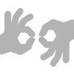

American and Indian Sign Languages to Speech
Project Speakable

Slide 2
Signs are to Eyes what Words are to Ears

Slide 3
1.
Problem Statement
There have been several advancements in technology and a lot of research has been done to help the people who are deaf and dumb. Aiding the cause, Deep learning and computer vision can be used too to make an impact on this cause.
Knowing sign language that plays a pivotal role in communication for the deaf and dumb is not something that is common to all. Thus, there shall be difficulty for them to express their intention.

Slide 4
2.
Project Description
To diminish the difficulty for the deaf and dumb in communicating with people who are not aware of sign languages, we developed a web application that generates Speech in English/Hindi in Male/Female voice from American/Indian Sign Language using Deep learning paradigms.

Slide 5
Project Development Roadmap
Collection of American and Indian Sign Language Datasets
Writing the sign recognition program
Implementing Text to Speech functionality in the Web Application
1
3
5
2
4
6
Training the preprocessed ASL and ISL datasets onto a CNN model and saving the models
Developing the Web Application UI that captures real-time video
Integrating the sign recognition functionality into the Web Application

Slide 6
Collection of Datasets
American Sign Language
4 members among our team have contributed in developing a dataset for the American Sign Language as the ones available in the internet are not preferable for our methodology of implementing sign language recognition.
There are 6480 images for training a model and 1620 images for testing its accuracy (Training set : Test set :: 4:1)
Indian Sign Language
The team working on Indian Sign Language to Text has provided us with the dataset they prepared.
There are 1800 images for training a model and 720 images for testing its accuracy.
(Training set : Test set :: 5:2)

Slide 7
CNN Model Architecture
Conv2D
MaxPooling2D
Conv2D
MaxPooling2D
Flatten
Dense
Dropout
Dense

Slide 8
Sign Recognition Algorithm
Load Trained ASL and ISL Models
Apply Gaussian Blur filter and threshold to the frame captured with OpenCV to get the processed image
After the first-hand prediction, we compare the result with similar letters and double-check our prediction by using classifiers made for sets of those similar letters.
Whenever blank symbol is recognized, the word generated till then will be moved as part of the sentence.
STEP 1
STEP 2
STEP 3
STEP 4
STEP 5
STEP 6
STEP 7
STEP 8
Start Live Video Feed and capture image frames from the camera
This processed image is passed to the CNN model for prediction.
If a letter is detected for more than 50 frames, then the letter is taken into consideration for forming the word.
The Sentence will keep on generating until the live video feed terminates

Slide 9
Technologies used for the Project
Web Application Frontend: HTML, CSS, JavaScript, jQuery
Web Application Backend: Flask
CNN Model Development: Python==3.10, Jupyter, Numpy==1.22.2, OpenCV==4.5.5, Keras==2.8.0, TensorFlow==2.8.0
English ↔ Hindi Translation: Google Translate API
Text to Speech generation: SpeechSynthesis Web API

Slide 10
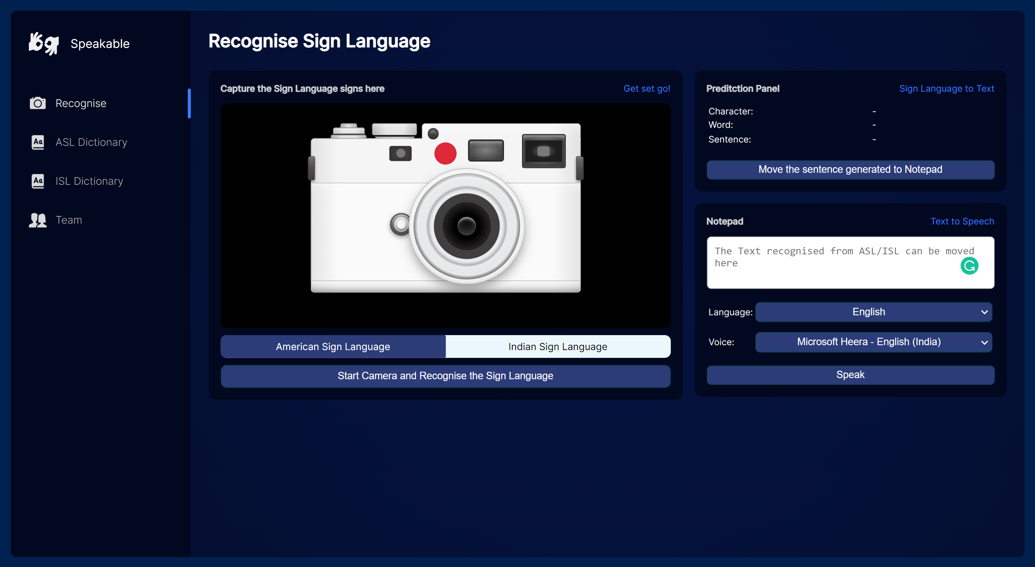
Demo of the Web Application

Slide 11
Thanks!
👍
Team
Karthik Sajjan
Karusala Deepak Chowdary
Killadi Venkata Jai Santeswar
Kuppa Venkata Krishna Paanchajanya
Vanga Manoj Sahit Reddy
Any questions?

